Slide 1
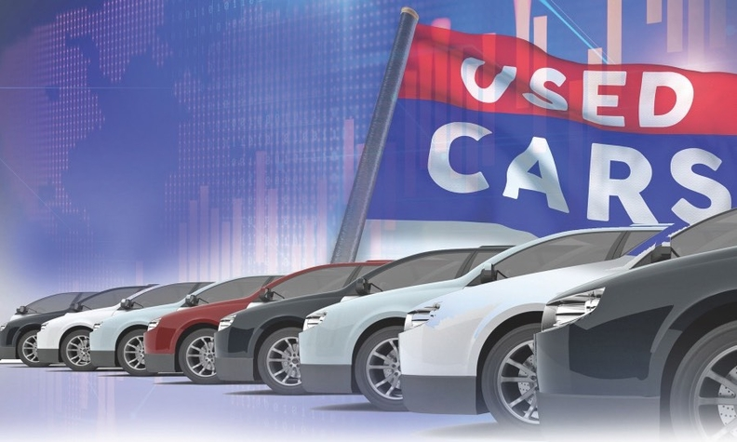


Exploratory Data Analysis on
By: SAURABH PANVELKAR
INSAID COHORT JAN 2021 BATCH

Slide 2
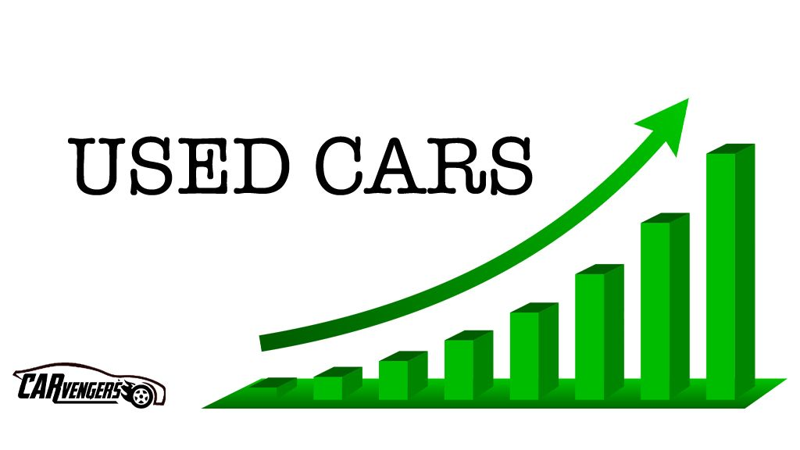
Introduction
The Indian used car market was valued at USD 27 billion in 2020, and it is expected to register a CAGR of 15% during the forecast period (2020-2025).
Covid -19 pandemic did not have a particularly negative impact on the industry.
With more people preferring individual mobility and the increase finance options infused into the used cars market, the market is set to grow considerably.
Factors, such as standardized dealership experience, good price experience, and high financing cost for used cars, may hinder the growth of the used car market.

Slide 3
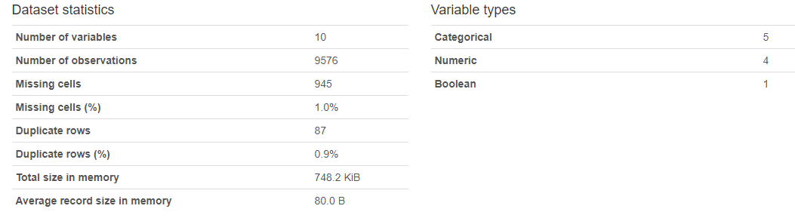
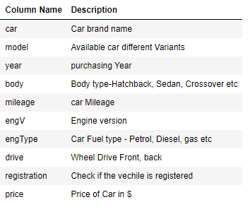
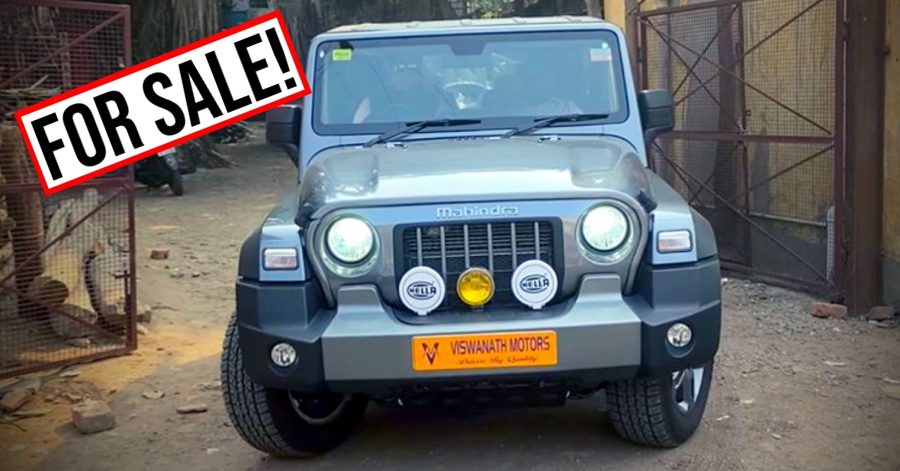
Data Description

Slide 4
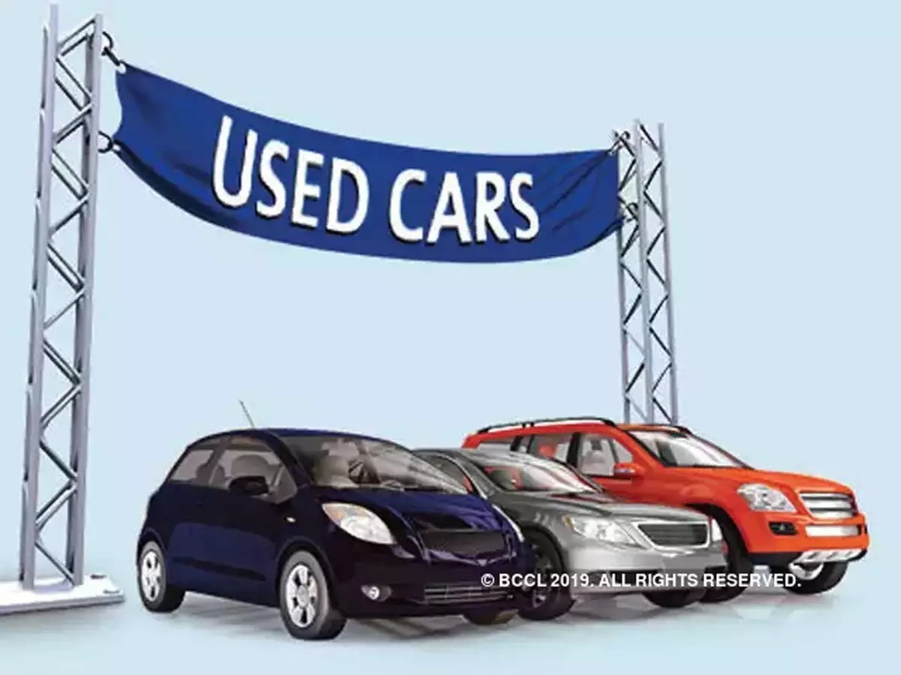
Problem Statement
Top 10 selling brands
Top 10 car models sold at highest price
Most purchased cars w.r.t. drive type
Most expensive cars w.r.t. drive type
Most preferred cars w.r.t. Car Body & Car engine
Car price relation with car year

Slide 5
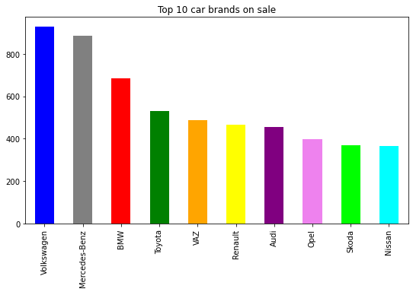
Which are Top 10 car brands on sale ?
The above graph indicates top 10 car brands based on sales volume.

Slide 6
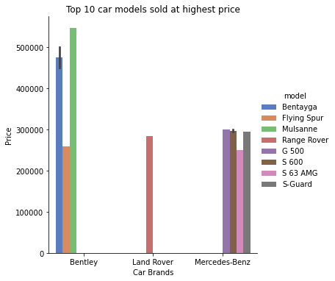
Which are the top 10 car models which are sold at highest price?
The above graph shows Bentley, Land Rover & Mercedes-Benz car brands' cars which are sold at highest price.

Slide 7
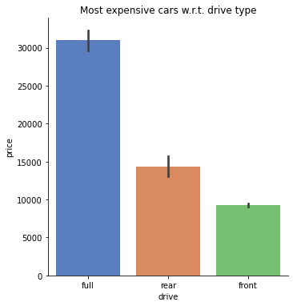
Which are most expensive cars w.r.t. drive type ?
Here we can see full drive type cars are most expensive one.

Slide 8
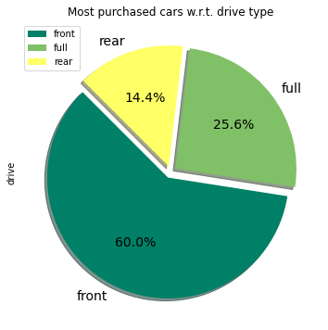
Which are most purchased cars w.r.t. drive type ?
Here we can see front drive type cars (60%) are most purchased by customers.

Slide 9
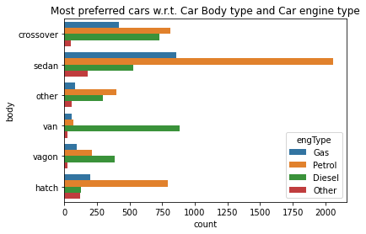
Which are most preferred cars w.r.t. Car Body type and Car engine type ?
Here we can see sedan with petrol type cars are most preferred by customers.

Slide 10
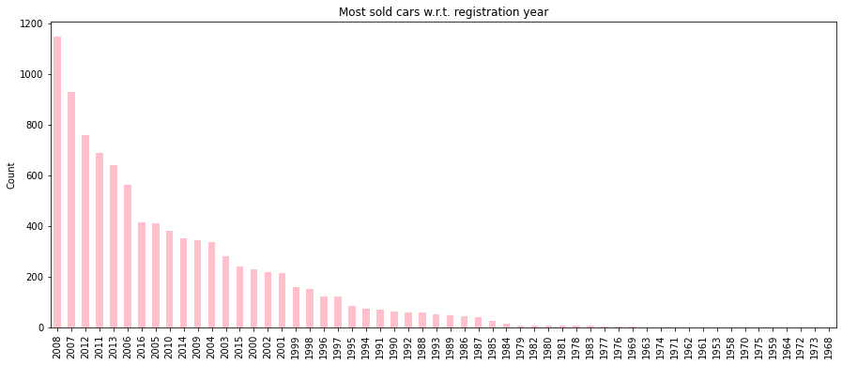
Which are most sold cars w.r.t. registration year ?
After analysing the chart, we can say that newer year registration cars are most by customers.

Slide 11
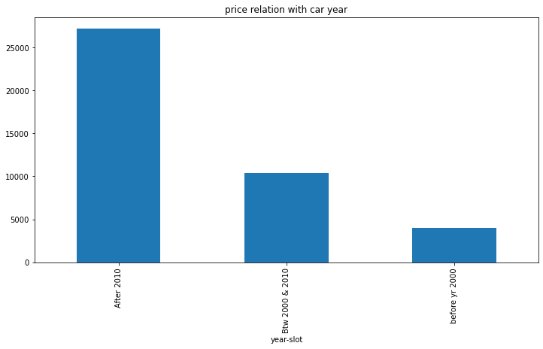
Price relation with car year.
After analysing the chart, we can say that newer cars are getting high price as compared to older cars.

Slide 12
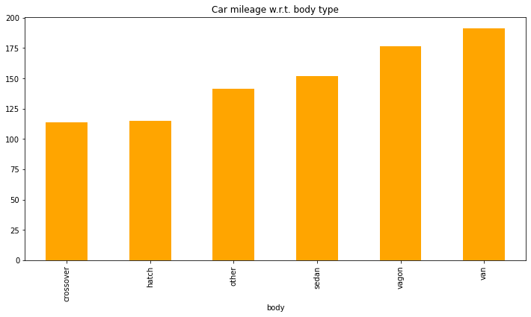
Which body type car is deriving high mileage ?
Here we can see van type cars are deriving high mileage.

Slide 13
Summary
Conclusion:
Sedans with petrol engine are more sought by buyers in used car segment as per the data.
Older models are not preferred by customers.
Van are deriving higher mileage, however, price quoted for high mileage cars are more.
Full drive cars are on expensive side, therefore, customers tends to buy front drive car which is relatively cheaper side.
Customer tends to buy newer car (by registration year), therefore, prices of newer cars are comparatively higher.
Insights:
Seller needs to increase stock of sedan cars with petrol engine.
Newer car w.r.t. registration year will provide more demand and higher price to cars.
Noted postive correlation for full drive cars and price, therefore seller should concentrate on selling full drive cars.
For increase in number of car sales, seller need to increase rear drive car stock.
Seller need to verify car mileage before procuring car in re-sale marker, since high mileage cars has more demand.

Slide 14


